Slide 1
Introduction to computer
Instructor: Engr. Hira Akash

Slide 2
Outline
Definition
Why computers
Characteristics of computer
Limitation of computers
Computer categories
Hardware
Software
System software
Application software
Bits and Bytes
Advantages of computer
Disadvantages of computer
Applications of computer

Slide 3
Definition
Computer is an electronic device that can accept input data, process data, store data and produce output according to set of instructions/ program.
A computer is a machine that manipulates data according to a list of instructions. A computer is a device capable of performing computations and making logical decisions at speed millions and even billion of times faster them human beings can.
Computer is an electronic machine which is use for data processing. The output which comes after processing data through computer is known as Information.

Slide 4
Diagram

Slide 6
Characteristics of computer
Speed:
The speed of a computer in processing information is increasing from time to time and computers can calculate at very high speed.
Accuracy:
The accuracy of a computer system is very high provided that the data and the program given to it are accurate.
Error in computer data processing is mostly human factor.
The program may be wrongly coded or the data may be wrongly entered.

Slide 7
Cont…
Storage:
Computers can store large amount of data using their memory unit
Versatility:
Computers can be programmed and applied for different purposes.
People can use computers for different applications.
Diligence:
The computer does the same thing repeatedly without saying “I am tired or I am bored”.

Slide 8
Limitations of computer
No I.Q:
A computer is a machine that has no intelligence to perform any task.
Each instruction has to be given to computer.
A computer cannot take any decision on its own.
Dependency:
It functions as per a user’s instruction, so it is fully dependent on human being

Slide 9
Cont…
Environment:
The operating environment of computer should be dust free and suitable.
No Feeling :
Computers have no feelings or emotions.
It cannot make judgment based on feeling, taste, experience, and knowledge unlike a human being.

Slide 10
Categories
A computer can be divided into two main categories:
1. Hardware
2. Software
Hardware
Hardware is basically anything that you can touch with your fingers.
Software
For computer hardware to work it must follow a set of instructions that is supplied to it as software.

Slide 11
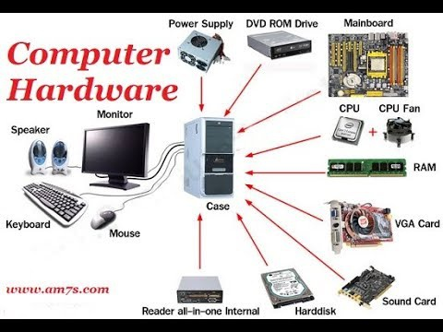
Hardware
Hardware refers to the computer’s physical components

Slide 12
Software
The term software refers to the set of instructions that directs the hardware to accomplish a task.
1. System Software
2. Application Software

Slide 13
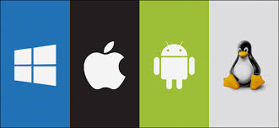
System Software/Operating System
System Software are used to control all components of computer and serves as an interface between user and hardware.
Control all components of computer
2. Interface b/w user and hardware

Slide 14
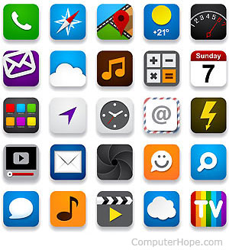
Application Software
Application software is used or design for the specific purpose of the user.
For example:
MS-WORD
MS-POWER POINT
MS-EXCEL
Corel Draw Paint
Game
MS-ACCESS

Slide 15
Bits and Bytes
Bit:
One digit, either 0 or 1
Byte: any combination of 0 or 1. also called an octet.

Slide 16
Computer only understand 0 or 1 0 OFF 1 ON

Slide 19
Advantage of computer
Easy processing of complex tasks.
It saves time by quick manipulation of data as compared to when done manually.
The errors in data processing are minimized when a computer is used.
It has helped in making communication easier by using internet.
It stores, retrieves, and processes a large amount of data.
It helps in multitasking of various jobs.

Slide 20
Disadvantage of computer
Un-Employment
Cyber-crime
Computer can perform only what is it programmed to do.
Computer need well defined instructions to perform any operation

Slide 21
Application of computer
Computer is playing very important role in every field of life.
Computers are everywhere such as at home, at school.
In daily life a large number of activities are dependent on computers.
The main fields where computer is playing very important role are:

